Slide 1






데이터베이스 실습
한양여자대학교
DB 쿼리 발표
2104637 박희선
2104649 양지연
2104689 전수진
2104714 황다은
팀명: 데스파

Slide 2






데스파 데이터베이스 소개
[2년제 학과]
- 패션디자인과(패디과)
- 실무영어과(실영과)
[3년제 학과]
- 유아교육과(유교과)
- 스마트it과(스아과)
- 치위생과
Department 5개
Course 3년제 x 과목6개 x 3학과 + 2년제 x 과목6개 x 2학과 = 78개
Professor 3 x 9 + 2 x 6 = 39명
Student 78명
Enrol 78 x 3 = 234개
Lecture 78개

Slide 3
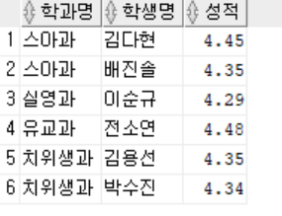
데스파 쿼리
장학금을 받을 수 있는 학생명과 학과명, 점수를 보이시오. (장학금 조건: 성적 4.25 이상)
SELECT dname AS 학과명, sname AS 학생명, QPA AS 성적
FROM Student, Department
WHERE Student.major = Department.dnum AND Student.QPA >= 4.25
ORDER BY dname, QPA DESC;

Slide 4
데스파 쿼리
2. 스마트it학과의 각 학년별 평균 성적을 보이시오.
SELECT dname AS 학과명, ROUND(AVG(QPA), 2) AS 학년별평균성적
FROM department, Student
WHERE Department.dnum = Student.major AND Student.year=1 AND Dname='스아과'
GROUP BY dname
UNION
SELECT dname, ROUND(AVG(QPA), 2)
FROM Department, Student
WHERE Department.dnum = Student.major AND Student.year=2 AND dname='스아과'
GROUP BY dname
UNION
SELECT dname, ROUND(AVG(QPA), 2)
FROM Department, Student
WHERE Department.dnum = Student.major AND Student.year=3 AND dname='스아과'
GROUP BY dname;

Slide 5
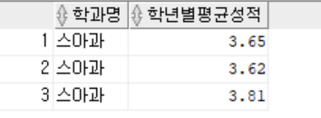
데스파 쿼리
2. 스마트it학과의 각 학년별 평균 성적을 보이시오.

Slide 6
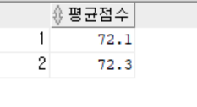
데스파 쿼리
3. 유아교육과의 1학년 A, B반의 평균 성적 차이를 보이시오
SELECT ROUND(avg(grade),1) AS 평균점수
FROM Enrol
WHERE cnum in(SELECT cnum
FROM Course
WHERE cnum like '331%1')
UNION
SELECT ROUND(avg(grade),1) AS 평균점수
FROM Enrol
WHERE cnum in(select cnum
FROM Course
WHERE cnum like '331%2');

Slide 7
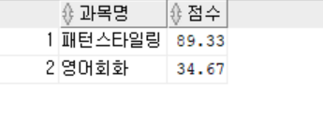
데스파 쿼리
4. 모든 과목 중 평균 점수가 가장 높은 과목과 가장 낮은 과목의 과목명과 점수를 보이시오.
CREATE VIEW Average
AS SELECT Course.cname AS 과목명,
ROUND(AVG(grade), 2) AS 평균
FROM Course, Enrol
WHERE Course.cnum = Enrol.cnum
GROUP BY Course.cname;
SELECT 과목명, 평균 AS 점수
FROM Department, Average
WHERE 평균 = (SELECT max(평균)
FROM Average)
GROUP BY 과목명, 평균
UNION
SELECT 과목명, 평균
FROM Average
WHERE 평균 = (SELECT min(평균)
FROM Average)
GROUP BY 과목명, 평균;

Slide 8
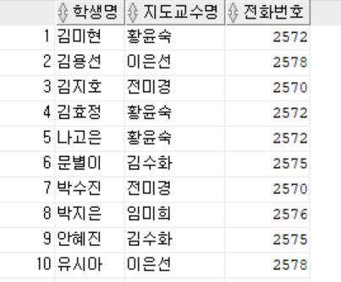
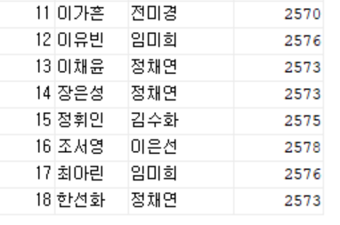
데스파 쿼리
5. 치위생과 모든 학생의 담당 지도교수명과 교수의 전화번호를 보이시오
SELECT sname AS 학생명, pname AS 지도교수명, pphone AS 전화번호
FROM Professor, Student, Department
WHERE Professor.pnum = Student.advise AND Department.dnum = Professor.belong AND
Department.dname = '치위생과’
ORDER BY sname;
.
.
.

Slide 9
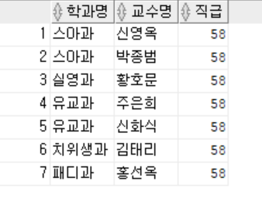
데스파 쿼리
6. 직급이 명예교수인 교수가 속한 학과명과 교수의 이름을 보이시오
SELECT dname AS 학과명, pname AS 교수명, ppos AS 직급
FROM Professor, Department
WHERE Department.dnum = Professor.belong AND ppos like '5_'
ORDER BY dname;

Slide 10
데스파 쿼리
7. 월요일 2교시에 하는 과목명과 이 과목을 수강하는 학생명을 보이시오
CREATE VIEW vw_LectureTest
AS SELECT cname, sname, Course.cnum, Student.snum, Lecture.time
FROM Course, Student, Lecture, Enrol
WHERE Course.cnum = Enrol.cnum AND Enrol.snum = Student.snum
AND Course.cnum = Lecture.cnum;
SELECT cname AS 과목명, sname AS 학생명, time AS 강의시간
FROM vw_LectureTest
WHERE time = 12;

Slide 11
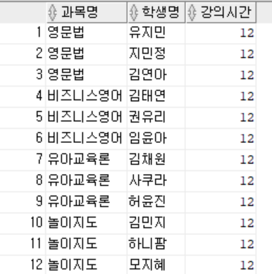
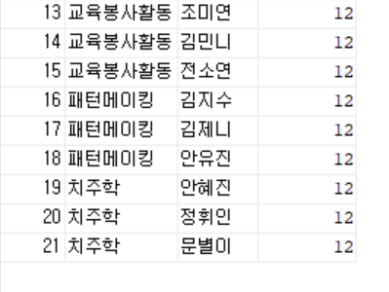
데스파 쿼리
7. 월요일 2교시에 하는 과목명과 이 과목을 수강하는 학생명을 보이시오
.
.
.

Slide 12
데스파 쿼리
8. 실영과 직급이 부교수인 교수명과 강의시간, 강의 수강 학생명을 보이시오
CREATE VIEW pposc
AS SELECT distinct dname AS 학과명, pname AS 교수명,
course.cnum AS 과목명, time AS 강의시간
FROM Department, Professor, Lecture, Course
WHERE Department.dnum = Professor.belong AND Professor.pnum = Lecture.pnum
AND Course.cnum = Lecture.cnum AND dname = '실영과' AND ppos LIKE '2%';
SELECT 학과명, 교수명, sname AS 수강생, 강의시간
FROM pposc, Student, Enrol
WHERE Student.snum = Enrol.snum AND Enrol.cnum = pposc.과목명
ORDER BY 강의시간;

Slide 13
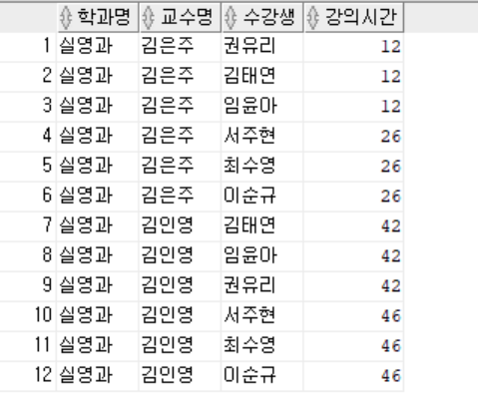
데스파 쿼리
8. 실영과 직급이 부교수인 교수명과 강의시간, 강의 수강 학생명을 보이시오

Slide 14
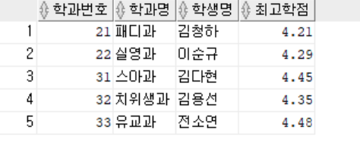
데스파 쿼리
9. 각 학과별로 성적이 가장 높은 학생명을 보이시오
CREATE VIEW sqpa
AS SELECT major as 학과, max(qpa)as 점수
FROM student
GROUP BY major;
SELECT dnum as 학과번호, dname as 학과명, sname as 학생명, 점수 as 최고학점
FROM Department, sqpa, Student
WHERE Department.dnum = sqpa.학과 and sqpa.점수 = Student.qpa
ORDER BY dnum;

Slide 15
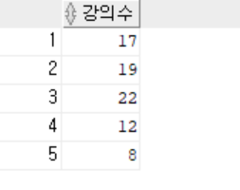
데스파 쿼리
10. 각 요일별 총 강의수를 보이시오.
SELECT Count(cnum) AS 강의수
FROM Lecture
WHERE time in (SELECT time
FROM Lecture
WHERE time like '1%'
GROUP BY time)
UNION
SELECT Count(cnum) AS 강의수
FROM Lecture
WHERE time IN (SELECT time
FROM Lecture
WHERE time like '2%'
GROUP BY time)
UNION
SELECT Count(cnum) AS 강의수
FROM Lecture
WHERE time IN (SELECT time
FROM Lecture
WHERE time like '3%'
GROUP BY time)
UNION
SELECT Count(cnum) AS 강의수
FROM Lecture
WHERE time IN (SELECT time
FROM Lecture
WHERE time like'4%'
GROUP BY time)
UNION
SELECT Count(cnum) AS 강의수
FROM Lecture
WHERE time IN (SELECT time
FROM Lecture
WHERE time like'5%'
GROUP BY time);

Slide 16





감사합니다💖💘💖

